Slide 1

Netflix Content Trends Analysis for Strategic Recommendations
DHARSHINI PRAJA
STU679318fa8f7821737693434

Slide 2

PROBLEM STATEMENT
Netflix has a vast and diverse content library consisting of movies and TV shows from multiple countries and genres. However, with increasing competition from other OTT platforms such as Amazon Prime Video and Disney+, Netflix must understand its content trends and audience preferences to make strategic decisions.
The problem is to analyze Netflix’s content catalog to uncover how the distribution of Movies vs. TV Shows, genre popularity, and country-wise contributions have evolved over time. This analysis will help identify content gaps, popular genres, and strategic opportunities for future content acquisition and production planning.

Slide 3
Project Description This project performs data analysis on Netflix’s catalog to uncover trends in Movies, TV Shows, genres, and country-wise content distribution. Using Python (Pandas, Matplotlib), the dataset was cleaned, analyzed, and visualized to identify popular genres, top contributing countries, and how Netflix’s content has evolved over the years. The insights help in making data-driven strategic recommendations for future content planning and global expansion.

Slide 4

WHO ARE THE END USERS?
Netflix Strategy and Content Teams – to plan future content acquisition and production.
Data Analysts and Business Decision Makers – to derive insights from viewing trends.
OTT Industry Researchers – to study global streaming trends and audience preferences.
Marketing Teams – to align promotional strategies with popular genres and regions.

Slide 5

Technology Used
Programming Language: Python
Libraries: Pandas, NumPy, Matplotlib, Collections
Platform: Google Colab
Tools: Power BI (optional for dashboard), GitHub (for project hosting)
Techniques: Data Cleaning, Exploratory Data Analysis (EDA), Data Visualization

Slide 6
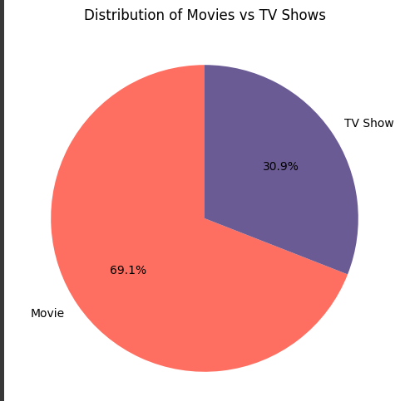
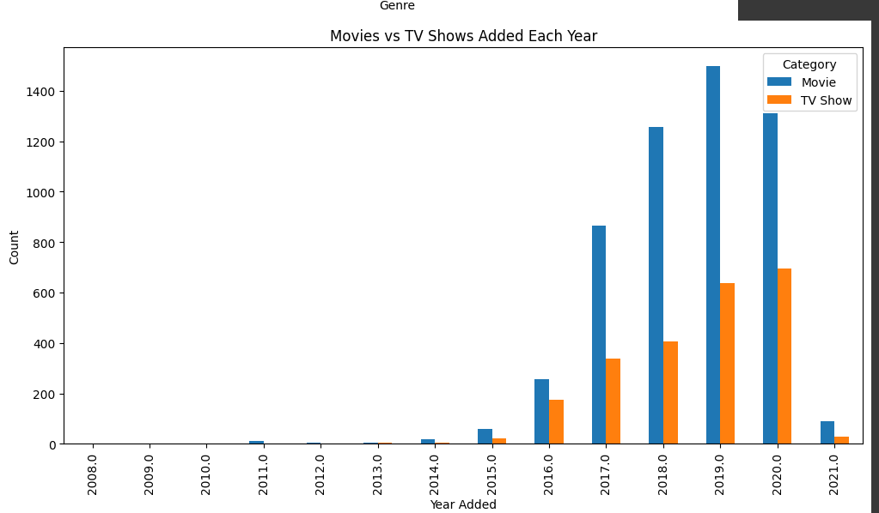
RESULTS1

Slide 7
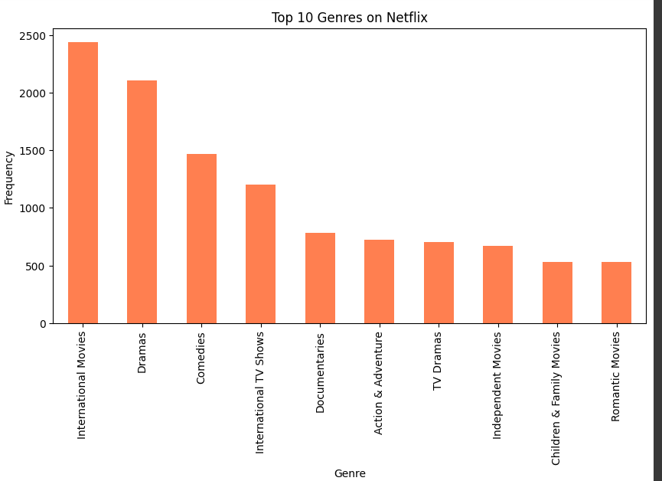
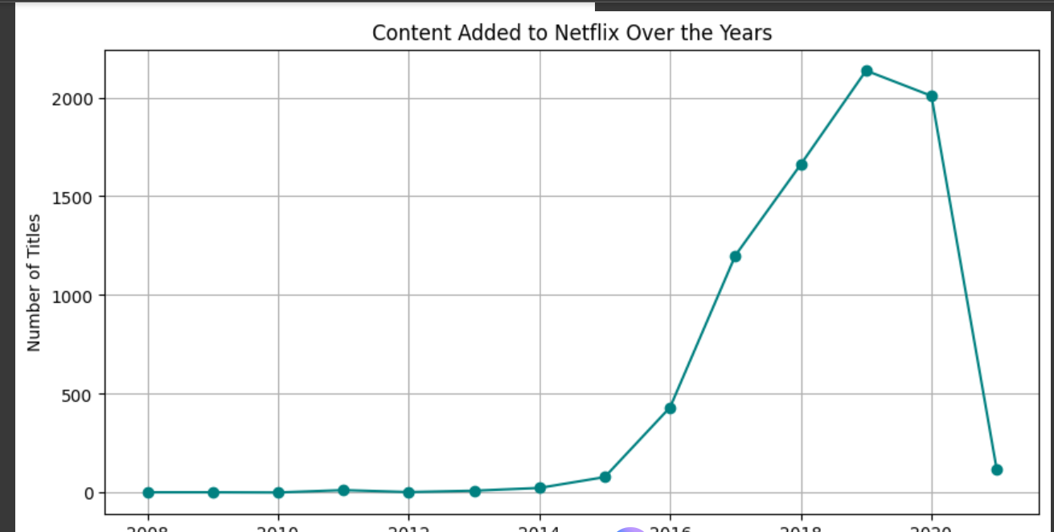
RESULTS2

Slide 8
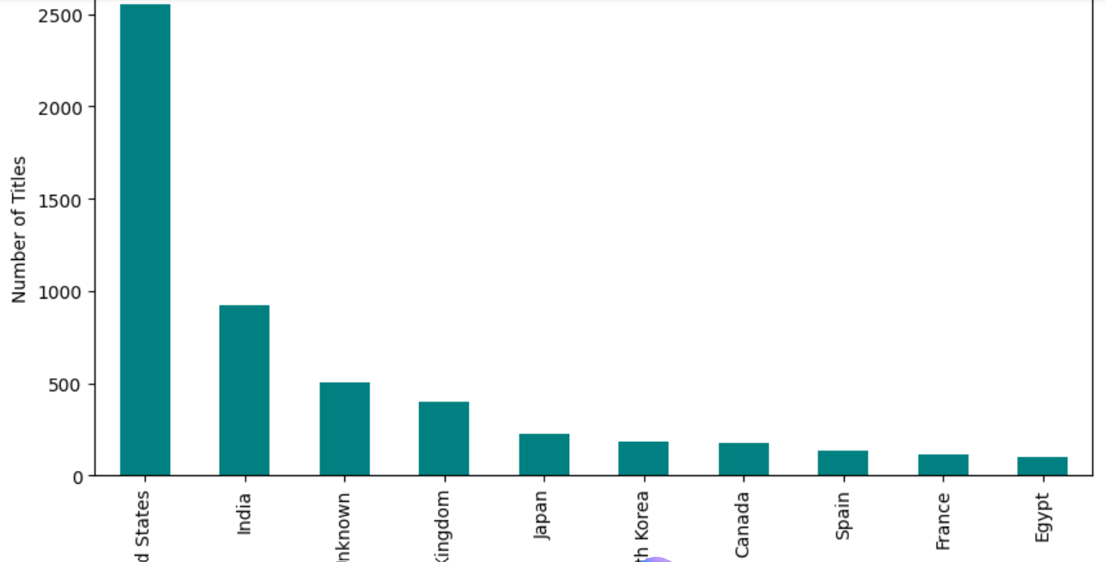
RESULTS3

Slide 9
GitHub repository
https://github.com/dharshinipraja/VOIS_AICTE_Oct2025_Netflix-Analysis_Dharshini-Praja

Slide 10

Getting started with Basics of Python Certificate

Slide 11

Data Visualization Certificate

Slide 12
Thank you
.
.
DHARSHINI PRAJA

